Slide 1
Egeria Webinar series
The session is for people looking to understand the metadata across their ecosystem in terms of the Egeria open types and instances using visualisations in the Egeria React User Interface. Understanding the types is important knowledge when developing connectors and new APIs like OMAS’s. This session will also show how metadata instances can be explored at a low level. This will be contrasted with an exploration of semantic data that is based on the Subject Area Open Metadata Access Service (OMAS). Zoom Conference https://zoom.us/j/523629111 | David Radley
https://wiki.lfaidata.foundation/display/EG/Egeria+Webinar+program

Slide 2
Webinar schedule part 1
Date | time | Title | Description | Presenter
Date change 6th 13th September 2021 | 15:00 UTC | Visualising a metadata eco system | The session is for people looking to understand the metadata across their ecosystem in terms of the Egeria open types and instances using visualisations in the Egeria React User Interface. Understanding the types is important knowledge when developing connectors and new APIs like OMAS’s. This session will also show how metadata instances can be explored at a low level. This will be contrasted with an exploration of semantic data that is based on the Subject Area Open Metadata Access Service (OMAS). Zoom Conference https://zoom.us/j/523629111 | David Radley
4th October 2021 | 15:00 UTC | What next after you have built a catalog. Part 1: the journey | Journey from manual cataloging, to using automated integration and cataloging. Metadata discovery will be covered here also. | Mandy Chessell
8th November 2021 | 15:00 UTC | Open lineage | This session will describe how to set up an Egeria production system where lineage can be visualised based on metadata from multiple sources. It will explain the Open Lineage standard and the Open Lineage services - two different things using the words "Open Lineage". This will include scenarios: metadata accessed using the OMRS repository connector proxy to a proprietary metadata repository A scenario with all open source content and no proprietary code. Lineage capture in various use cases Consolidated view | ING Bank (TBA) and Mandy Chessell

Slide 3
Webinar schedule part 2
Date | time | Title | Description | Presenter
6th December 2021 | 15:00 UTC | Kubenetes operators and Egeria | This session will cover how easy it is to run Egeria in Kubenetes and how the Egeria Kubenetes operator can be used to manage Egeria in a Kubenetes environment. | Nigel Jones
10th January 2022 | 15:00 UTC | Time Travelling with Egeria | Every wanted to know what the state of your metadata was at some specific time in the past? This session will introduce the Crux open metadata repository that supports these historical metadata queries. | Chris Grote
7th February 2022 | 15:00 UTC | How to build a repository connector | Every wanted to build an OMRS repository connector? This session will take you though what the considerations are and you need to do. It will show how to create the simplest "Hello World" connector. | Chris Grote
7th March 2022 | 15:00 UTC | How to build an integration connector |  | Mandy Chessell
4th April 2022 | 15:00 UTC | What next after you have built a catalog. Part 2: making it real | Making it real in your organisation. What are the infrastructure and culture changes that drive successful management of data? | Mandy Chessell
9th May 2022 | 15:00 UTC | What next after you have built a catalog. Part 3: strategic view | Becoming more mature with data governance, eventually enabling data citizenship. Data citizenship within an organization supports people who need access to data to be effective in their role. This data access needs to be embedded in the tools that they use and flexible enough to meet the changing challenges they face day to day. Since the data landscape is also changing, the tools that these people use need to be integrated with the data catalog. | Mandy Chessell

Slide 4
Visualising a metadata eco system
David Radley

Slide 5
Agenda
Open types overview and recap
Visualisations
Demo

Slide 7
Functional organisation

Slide 8
Egeria – vendor neutral integration
Use cases,
Personas,
Practitioners
input
Search
Open Metadata Access Services
Open Metadata Repository Services
Data integration, availability and integrity best practices
Notes:
So what
Is it important to you to consistently govern, manage, automate, analyze data and effectively drive AI?

Slide 9
Egeria – vendor neutral integration
Search
Open Metadata Access Services
Enterprise OMRS
Open Metadata Repository Services
OMRS communication and
APIs use standard open
Types, so vendors can
refer to data orientated
objects like asset in a
standard (vendor neutral)
way.
Notes:
So what
Is it important to you to consistently govern, manage, automate, analyze data and effectively drive AI?

Slide 10
OMAS and OMRS
Application
OMAS client API
Metadata repository server
Metadata repository server
OMAS rest service
Metadata repository server
Open Metadata Access Services rest
Metadata repository server
Enterprise OMRS
Enterprise OMRS
Local OMRS
Local OMRS
Each repository can support a subset of the open types

Slide 11
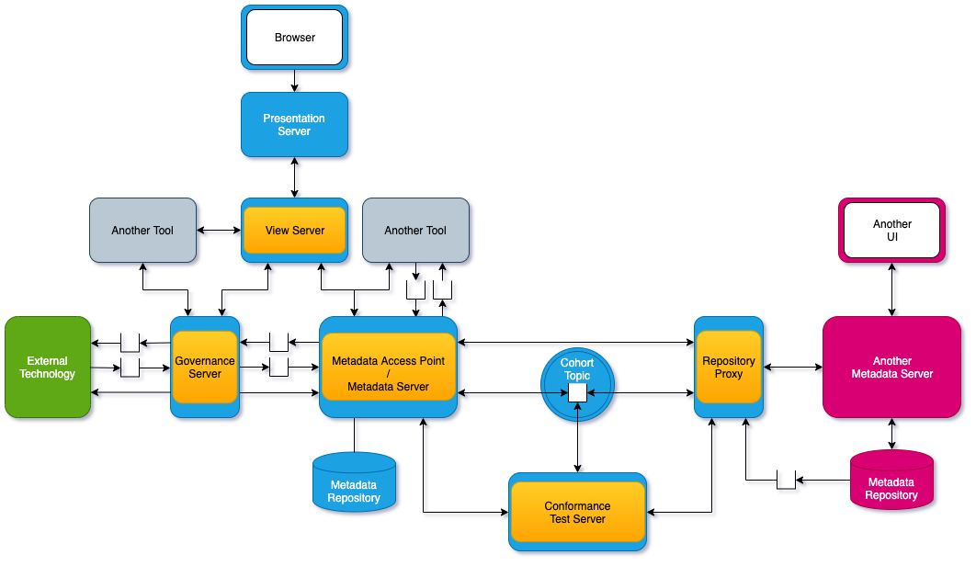
The high level architecture
https://egeria.odpi.org/open-metadata-publication/website/planning-guide/

Slide 12










Integrate information about data much easier.
Patterns before Egeria
Egeria world
Map once to OMRS
Silos
OMRS
Base API to build higher level API (e.g. OMAS)
Dynamic
(federated queries)
Point to point. Many mappings
One off - Point in time import

Slide 13




Egeria open types – building blocks
Entities, relationships and classifications are like elementary particles. Everything is made of them.
OMRS Types are like atoms. Grouped like the periodic table. Certain types can be related to other types (like atoms can bond to other atoms).
OMAS Types are like molecules – consisting of groups of types. A molecule can relate to other molecules. Molecules can behave in ways that their constituent parts do not.
Governance processes. This is more like organic material, with life having processes to maintain stability, integrity, sustainability, growth wellbeing.
Integration – community

Slide 14
OMRS Entities, Relationships and Classifications – reading the UML
Type names are circled

Slide 15
Type and attribute type Definitions
AttributeDefs
TypeDefs
EntityDef
EnumDef
ClassificationDef
CollectionDef
Array
Struct
Map
RelationshipDef
PrimitiveDef
Int
date
Int
date
Int
date
The formal metamodel is
https://odpi.github.io/egeria-docs/types/metamodel/
Int

Slide 16
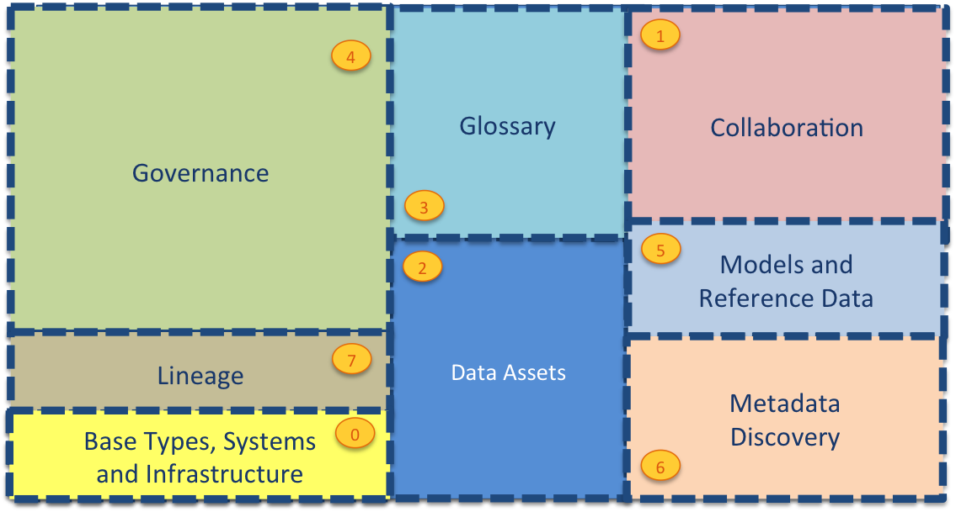
Open types
Linuga
Franca
Trade language
Communication facilitator
OPEN – not owned by any vendor
Extensible
https://egeria.odpi.org/open-metadata-publication/website/open-metadata-types/

Slide 17
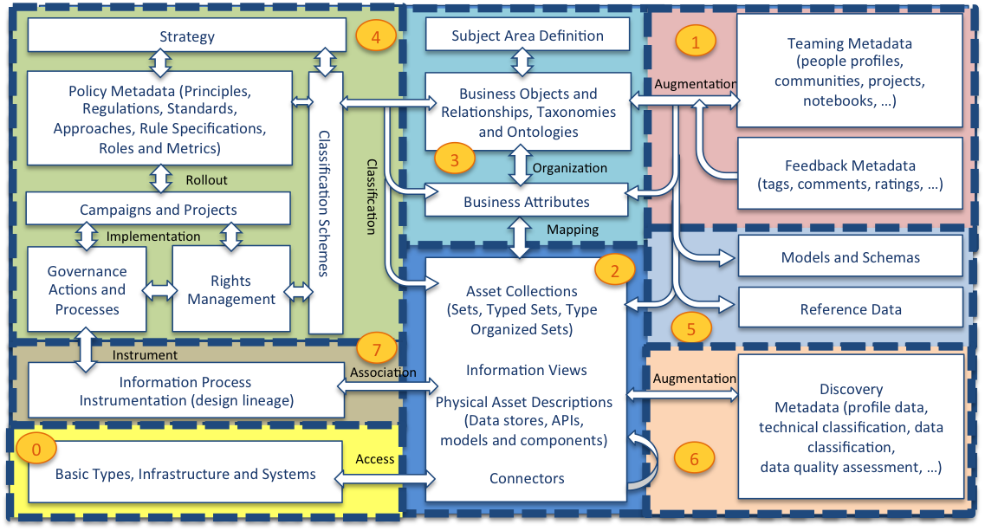
Open types in more detail
https://egeria.odpi.org/open-metadata-publication/website/open-metadata-types/Area-3-models.html

Slide 18
Open types can change too!
TypeDef
Properties
options
External mapping standards
Valid instance status
supertype
TypeDefPatches describe a change (patch) to a typedef:
- is not possible to delete an attributeTypeDef through a patch.
- you can deprecate an existing type
- no breaking changes!

Slide 19
Startup – bring in the types
Startup
The open types archive, including all the patches. So all the previous types are supported
Any other archives that are defined in the configuration are brought in, this can bring in instances and types.
The open type live in Git in code as an open metadata resource here:
https://github.com/odpi/egeria/tree/master/open-metadata-resources/open-metadata-archives/open-metadata-types

Slide 20
Open types in json
In you want to see the types in json
Generate the json file using OpenMetadataTypesArchiveUtility
Or in the content pack
find . -name 'OpenMetadataTypes.json'
./open-metadata-distribution/open-metadata-assemblies/target/egeria-3.2-SNAPSHOT-distribution/egeria-omag-3.2-SNAPSHOT/content-packs/OpenMetadataTypes.json
./content-packs/OpenMetadataTypes.json

Slide 21
Open Types
Startup log
OMRS-AUDIT-0303 The local server has updated an existing type called OpenDiscoveryAnalysisReport with a unique identifier of acc7cbc8-09c3-472b-87dd-f78459323dcb to version number of 4 using a patch from Egeria (3.2)
OMRS-AUDIT-0303 The local server has updated an existing type called Annotation with a unique identifier of 6cea5b53-558c-48f1-8191-11d48db29fb4 to version number of 2 using a patch from Egeria (3.2)
Total types: 648
Deprecated types: 36

Slide 22
Releases and approved types
The types for each release are managed in separate classes. For example:
OpenMetadataTypesArchive - new candidate types for current release
OpenMetadataTypesArchive3_1 - approved types added for 3.1 release
OpenMetadataTypesArchive2_11 - approved types added for 2.11 release
OpenMetadataTypesArchive2_10 - approved types added for 2.10 release
OpenMetadataTypesArchive2_9 - approved types added for 2.9 release
OpenMetadataTypesArchive2_8 - approved types added for 2.8 release
OpenMetadataTypesArchive2_7 - approved types added for 2.7 release
OpenMetadataTypesArchive2_6 - approved types added for 2.6 release
OpenMetadataTypesArchive2_5 - approved types added for 2.5 release
OpenMetadataTypesArchive2_4 - approved types added for 2.4 release
OpenMetadataTypesArchive2_0 - approved types added for 2.0 release
OpenMetadataTypesArchive1_7 - approved types added for 1.7 release
OpenMetadataTypesArchive1_6 - approved types added for 1.6 release
OpenMetadataTypesArchive1_5 - approved types added for 1.5 release
OpenMetadataTypesArchive1_4 - approved types added for 1.4 release
OpenMetadataTypesArchive1_3 - approved types added for 1.3 release
OpenMetadataTypesArchive1_2 - approved types added for releases before 1.3
All types have only been extended with non-breaking changes.
Breaking changes include:
Delete of an attribute
Changing a mandatory attribute to optional
Swapping the ends of a relationship
Instead - we deprecate and add a new type.

Slide 23
Visualisations
A proprietary metadata repository can continue to use its UIs and or the Egeria Uis. Egeria is an AND not an OR.
Egeria Dojo showcases use cases using scenarios written in Jupyter notebooks
Egeria UI – for general users. Allows Assets and lineage to be explored.
Egeria React UI – for the roles in the governance team. Uses technologies including React, nodejs, D3.

Slide 24
Egeria visualisations
Give a view across the Egeria eco-system,
across repositories,
across content from different technologies
across content in different implementations and formats.
New contributors welcome.

Slide 25


Visualising at different levels
Visualising at a higher level
Visualising at the lower level
Future enhancements:
Community profile
Asset owner

Slide 26
Demo…

Slide 27
Egeria Webinar series next webinar details
4th October 2021 | 15:00 UTC | The Value of Egeria | This session is for people wanting to understand the value of Egeria in enabling data centric, metadata driven integration. | Mandy Chessell
https://wiki.lfaidata.foundation/display/EG/Egeria+Webinar+program

